Slide 1
Neural Architectures:
Normalization techniques and skip connections
Introduction to Deep Learning: Class 5.2

Slide 2
Agenda and Pre-read
Agenda:
Batch and layer normalization
RMSNorm
Backprop math through batch/layer norm layers
Residual learning and Resnets
Data augmentation techniques in computer vision
Training a Resnet on Cifar 10 with/out Batch norm and Residual connections
Forward and backward pass in low precision

Slide 3
Batch and Layer normalization
Normalization layers help optimization (make training easier/faster/more stable).
During training, the distribution of activations inside a network can drift. This can cause saturated non-linearities (tiny gradients), sensitivity to learning rate, slow and unstable convergence.
By keeping activations roughly zero-mean/unit-variance, normalization reduces exploding/vanishing behavior and makes learning less sensitive to scale.
With learnable lambda and beta, the model can still represent what it needs.

Slide 4
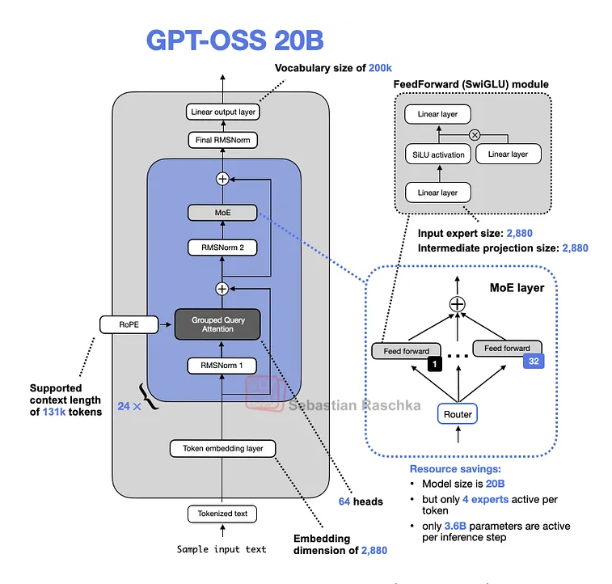
GPT 20b OSS Model

Slide 5
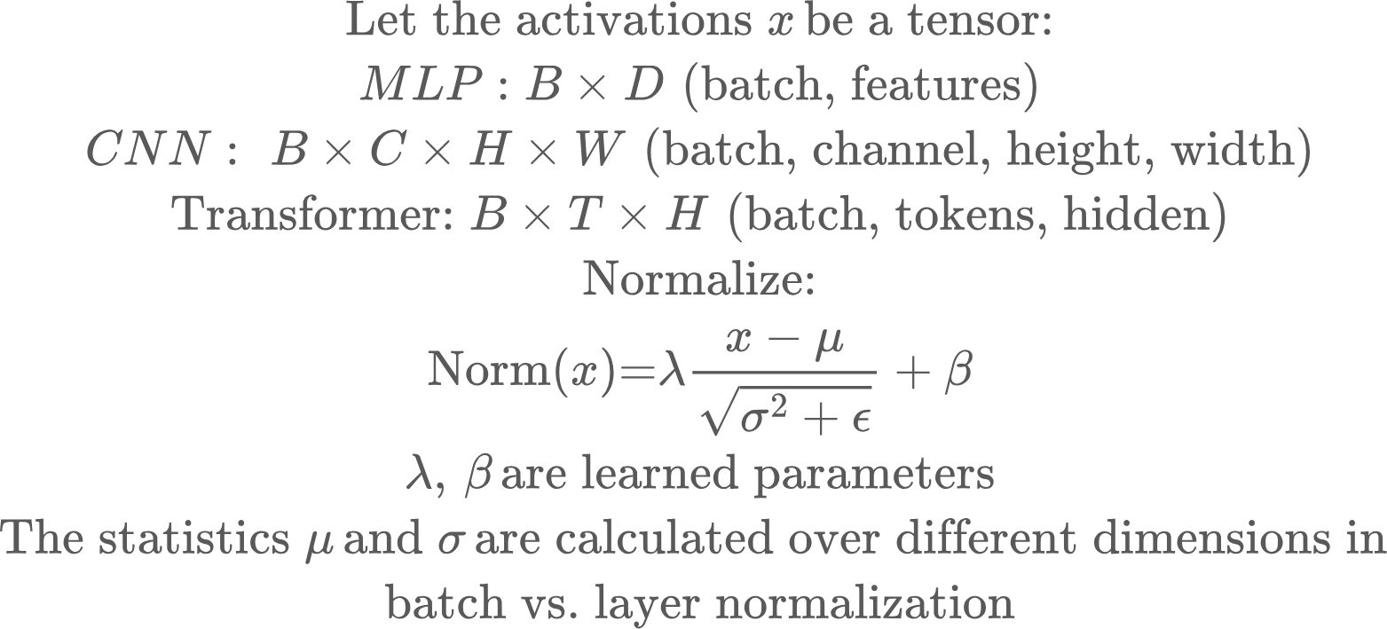
Batch and Layer normalization
Linear
Activation
Linear
Norm
Activation

Slide 6
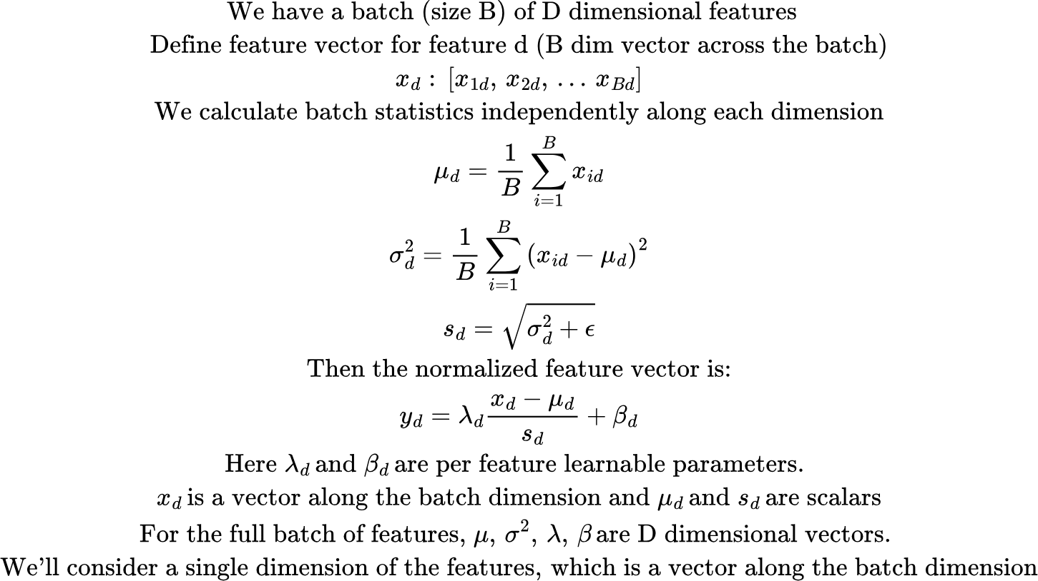
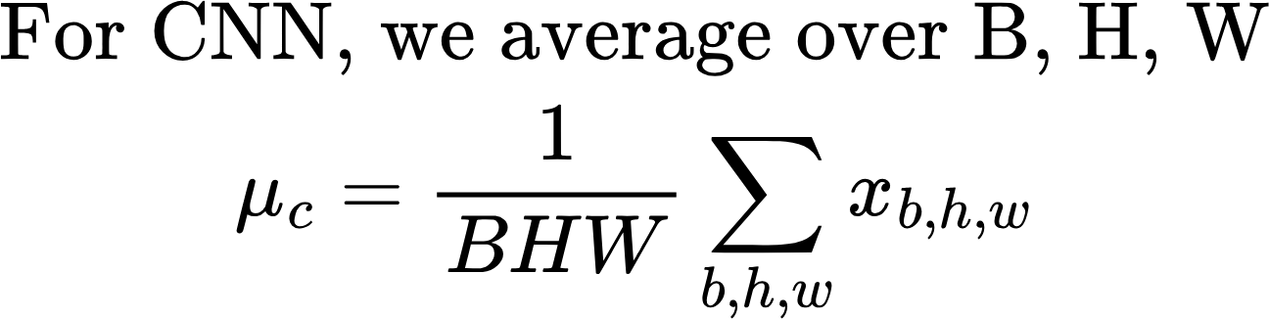
Batch Normalization
During inference, we typically don’t have a batch.. So we use running averages for mu and sigma calculated during training. These are saved along the model parameters

Slide 7
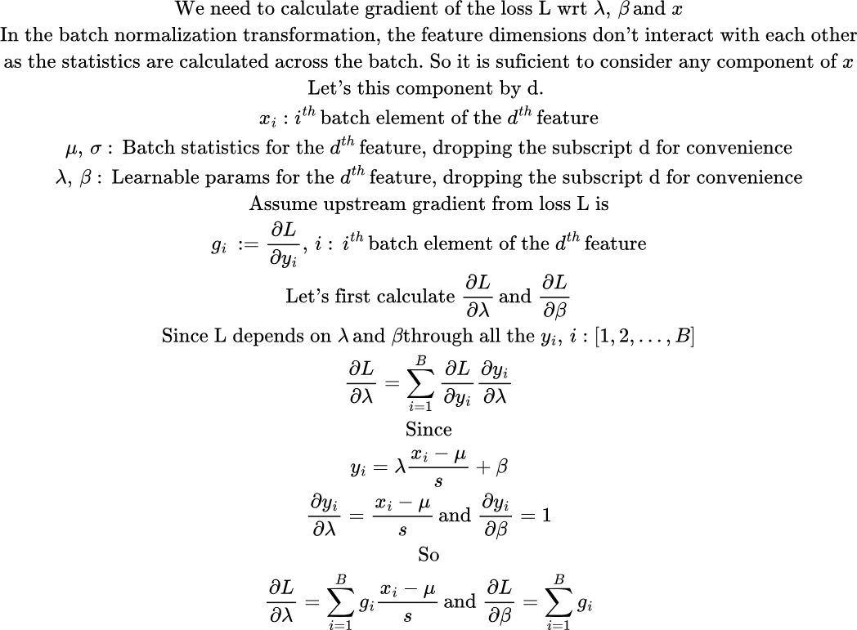
Batch normalization: Calculating gradients

Slide 8
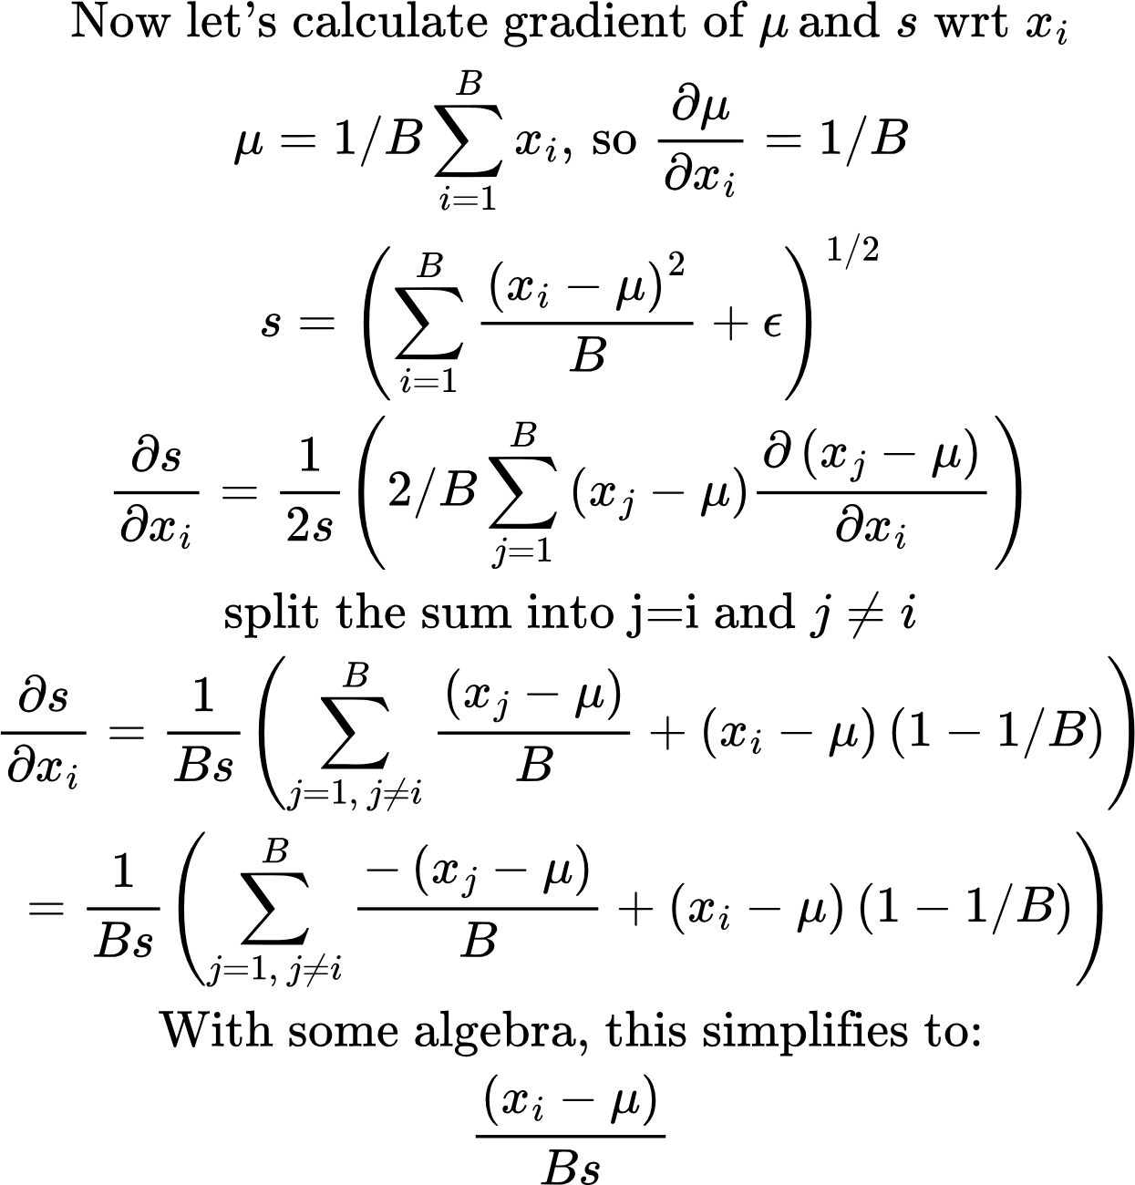
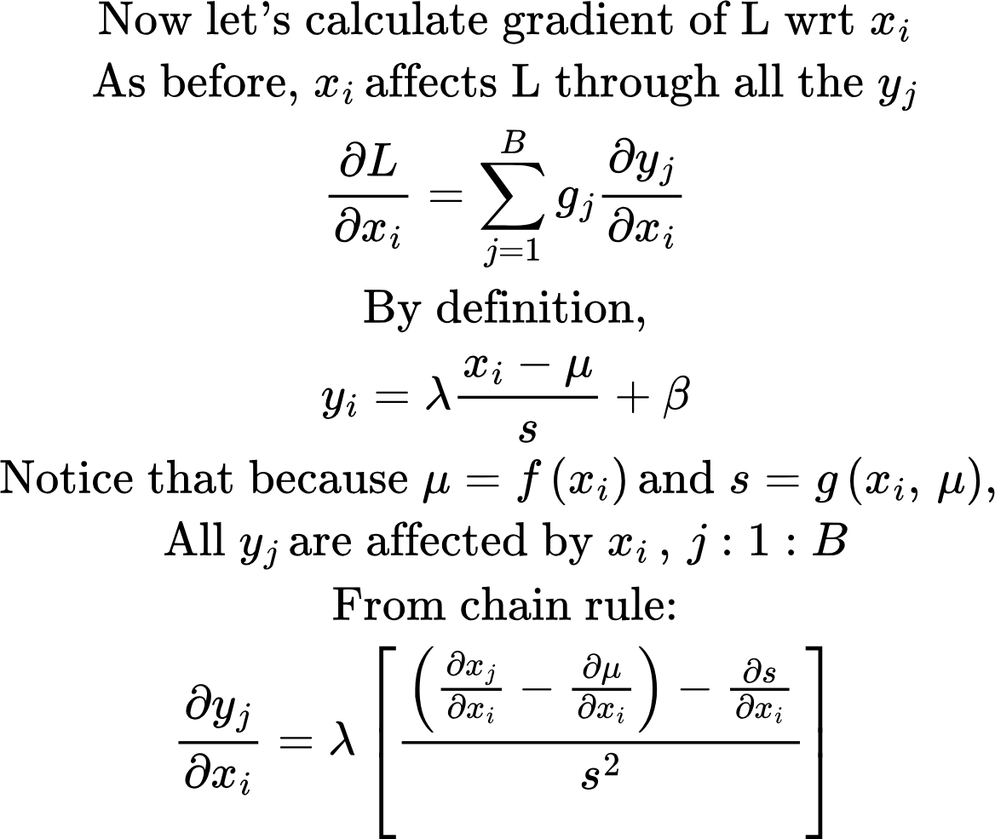
Batch normalization: Calculating gradients
derivative_mu_std.py

Slide 9
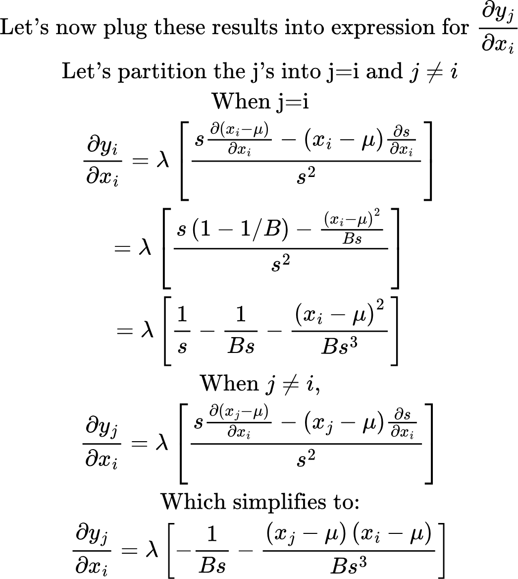
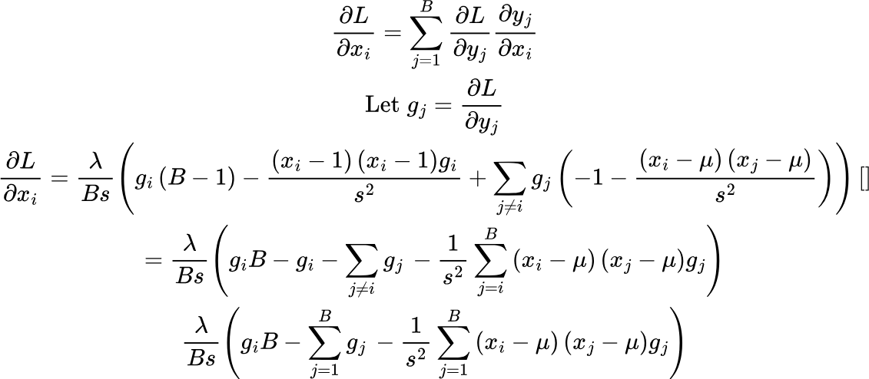
Batch normalization: Calculating gradients

Slide 10
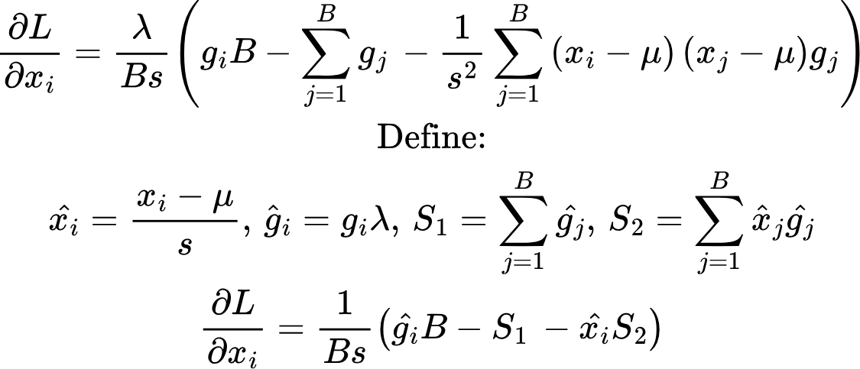
Batch normalization: Calculating gradients
batch_norm_derivatives.py

Slide 11
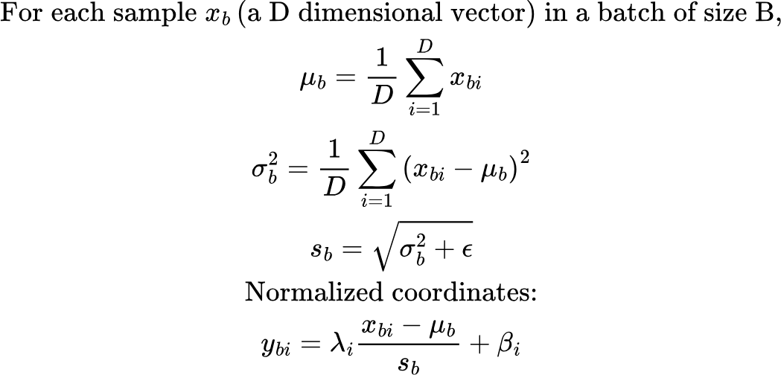
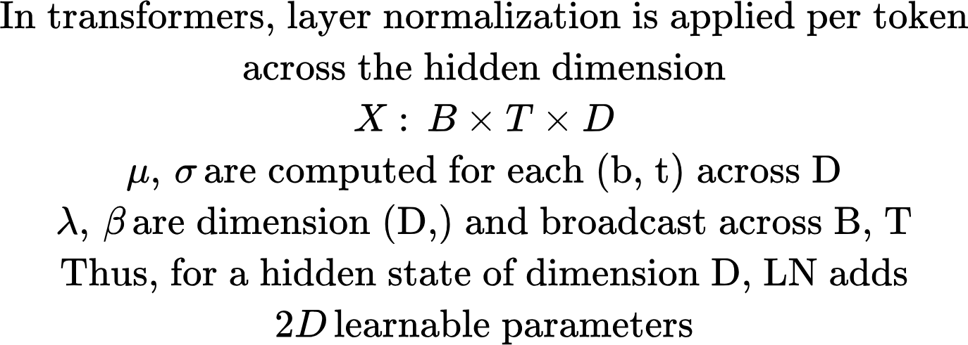
Layer Normalization
In layer normalization, we normalize across features of each input. This works well across any batch size and is the default in Transformer models. Same computation during training and inference, no need to save any running stats

Slide 12
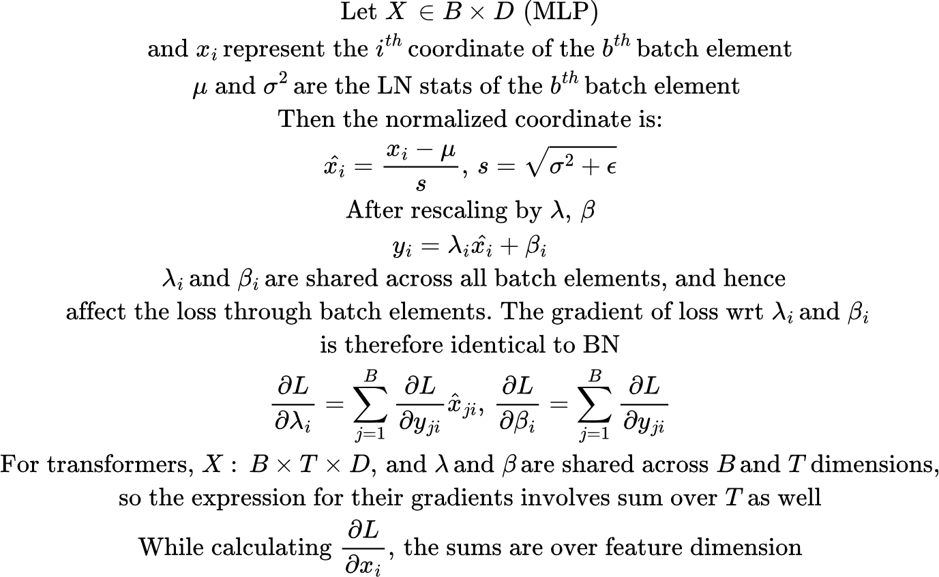
Layer normalization: Gradients

Slide 13
Residual Learning (skip connections)
Core idea: Instead of asking a layer to learn a full transformation H(x), residual learning asks it to learn a correction to the input
y = x + F(x)
x: The input F(x): Output of some stack of layers (Conv + Norm + Relu in CNN, Attention + MLP in Transformers..)
If F(x) = 0, the layers becomes the identity map y = x. That makes it easier for deep layers to not break learning.
Intuition: Layers of a neural network learn different representations of the input. Many useful transformations are “small edits” to a representation, rather than totally different representation every layer. With residual learning, the model can start near identity and gradually refine.
Residual learning allows a layer to “do nothing”, if needed.

Slide 14
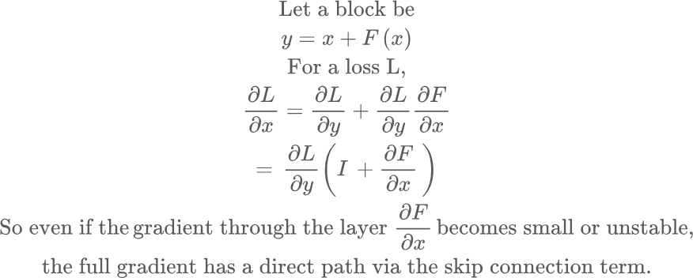
Residual Learning: Better gradient flow
Residual learning results in better gradient flow and reduces vanishing/exploding gradients

Slide 15
Common patterns
Shortcut with 1D conv, if spatial dimension change
1D conv
x
Conv1
Batch Norm
Non
Linearity
Conv2
Batch Norm
x
Layer
Norm
Attn
Layer Norm
MLP

Slide 16
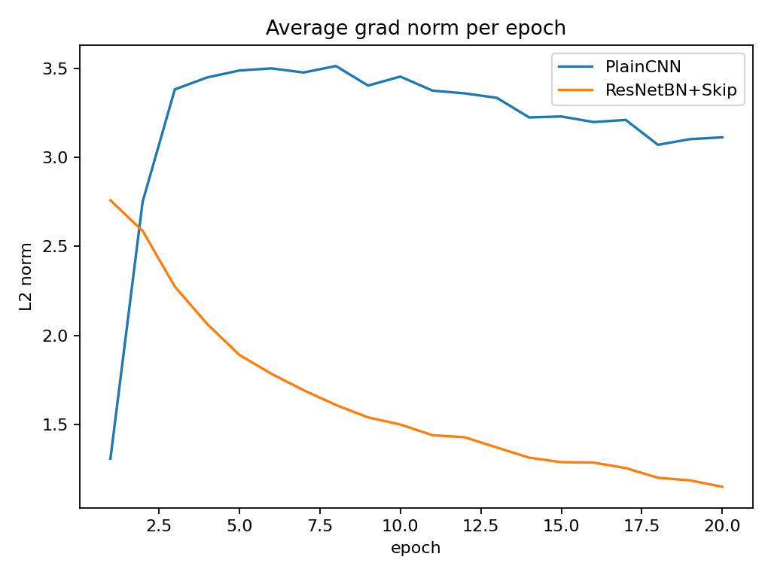
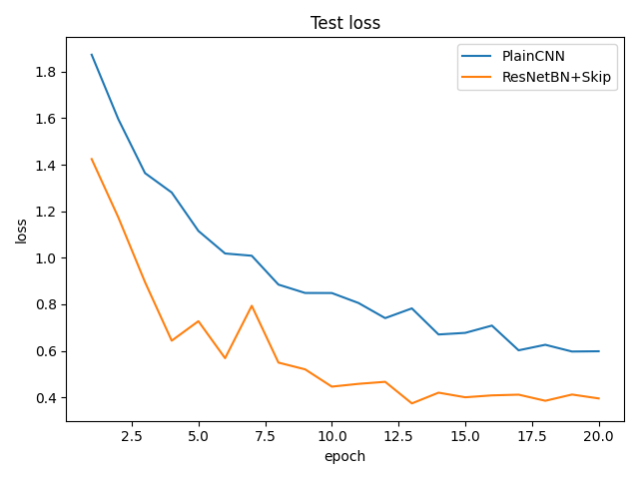
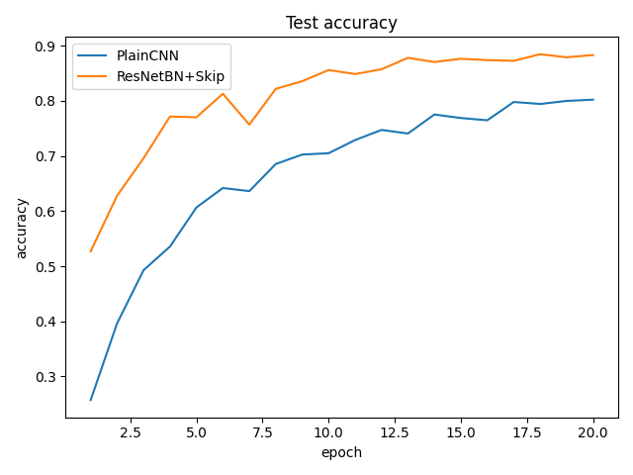
Plain CNN vs Batch Norm + Skip Connections
PlainCNN: params=2734090 best_test_acc=0.802 last_test_acc=0.802
ResNet + Batch Norm : params=2777674 best_test_acc=0.884 last_test_acc=0.883
cifar10_cnn_vs_resnet_bn.py.py

Slide 17
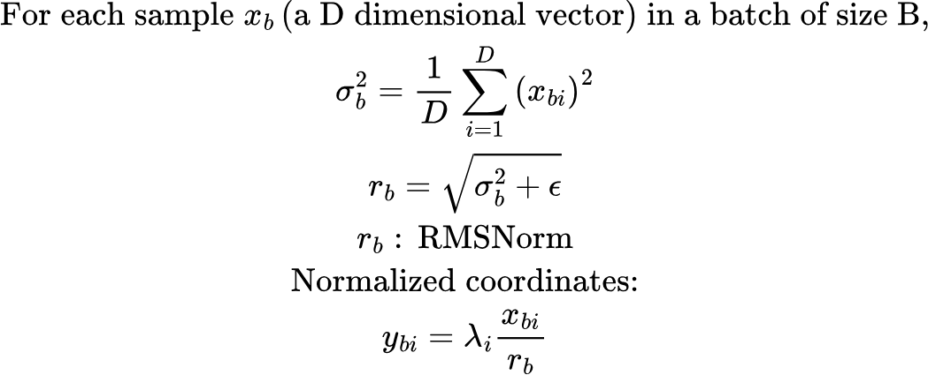
RMS Normalization (RMSNorm)
Modern transformers use a simpler version of Layernorm called RMSNorm. RMSNorm removes the centering by the mean..

Slide 18
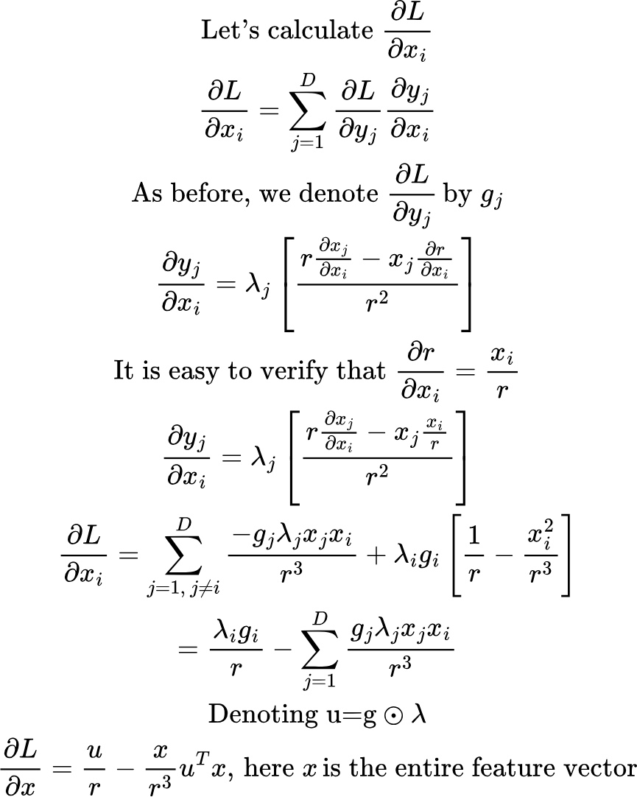
RMSNorm: Backprop
The derivative of loss against lambda is identical to Layernorm.

Slide 19
Common tricks..
Data augmentation
Setting up a convolutional network with downsampling points (using striding) accompanied by increase in channels
In the batch normalization + residual connection implementation, using the concept of blocks. Each block has several convolutional layers. First convolutional layer halves the spatial dimension and doubles the number of channels.
In the residual connection, add a 1d conv if spatial dimension change

Slide 20
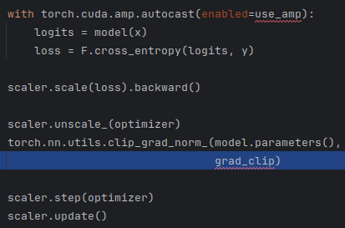
Using lower precision data types in the training loop
Once the gradients have been calculated, we scale them back to the original scale. Generally gradients are represented in full precision at this step, so underflow isn’t an issue
Affects ops executed inside the context by choosing a “fast” dtype for each op (fp16/bf16 for many GEMMs/convs, fp32 for numerically sensitive ops like some reductions/softmax parts, etc.)
If we computed gradients also in a lower dtype (eg., fp16), small gradients might underflow to 0. So, we scale up the loss and then calculate the gradients. This way gradient flow is preserved. Also, gradients often sum many contributions. In low precision, when you add a tiny number to a running total, the tiny increment can get rounded away.
It looks at all gradients together (over all parameters), computes a global norm (usually L2), and if that norm is bigger than your threshold grad_clip, it multiplies every gradient tensor by the same factor so the global norm becomes grad_clip.It prevents large parameter updates due to gradient spikes.
Default precision:
Total execution time = 2.549 sec
Max memory used by tensors = 2.78 GB
Mixed precision:
Total execution time = 1.354 sec
Max memory used by tensors = 2.76 GB
checks if any grads are inf/nan. If yes, it skips optimizer.step().
Adjusts S (down if overflow happened; up slowly if things are stable)
full_vs_mixed_precision_timing.py

